Slide 1

Digital Design & Computer Architecture
Presentation By
2620040005 – Pranav Nair Pallikkal
2620030289 – N Siva Sai Sarvan
2620040032 – T Piyush Sreeniketh
2620040039 – Naruna Nirbhay
Group Project
Batch 11
Design and Simulation of an Automatic Street Light Control System

Slide 2
Automatic Street Light Control System
Introduction
Street lights are essential for safe and efficient road illumination.
Traditional street lights may remain ON even during daylight, causing energy wastage.
An automatic control system uses a Light Dependent Resistor (LDR) to detect surrounding light intensity.
The system automatically turns the lights ON at night and OFF during the day.
This helps in saving energy, reducing human intervention, and improving efficiency.

Slide 3
Automatic Street Light Control System
Problem Statement
Street lights are often controlled manually or using fixed schedules.
Lights may remain ON during daylight hours, resulting in unnecessary energy consumption.
Manual operation requires human intervention and regular monitoring.
Inefficient control can lead to higher electricity costs.
A reliable automatic lighting control system is needed to reduce energy wastage.

Slide 4
Automatic Street Light Control System
Objectives
Automate street light operation based on surrounding light intensity.
Automatically turn ON the lights during darkness.
Automatically turn OFF the lights during daylight.
Reduce energy consumption and avoid unnecessary usage.
Minimize human intervention and improve system efficiency.

Slide 5
Automatic Street Light Control System
Main Components
LDR Sensor → Control Circuit → Switching Device → Street Light
LDR Sensor: Detects the surrounding light intensity.
Control Circuit: Processes the LDR signal and decides whether the light should be ON or OFF.
Switching Device: Controls the power supplied to the street light.
Street Light: Automatically turns ON in darkness and OFF in daylight.
Working Flow
Daylight → LDR detects light → Control circuit → Light OFF
Darkness → LDR detects low light → Control circuit → Light ON

Slide 6


Automatic Street Light Control System
Logic Gates Behind The System
AND Gate
NOT Gate
A
AND Gate
Y = A . B
A
NOT Gate
Y =Ā
B
Output is 1 when both inputs are 1
Single output that performs logical negation
Truth Table
Truth Table
A | B | Y = A . B
0 | 0 | 0
0 | 1 | 0
1 | 0 | 0
1 | 1 | 1
A | Y = Ā
0 | 1
1 | 0

Slide 7
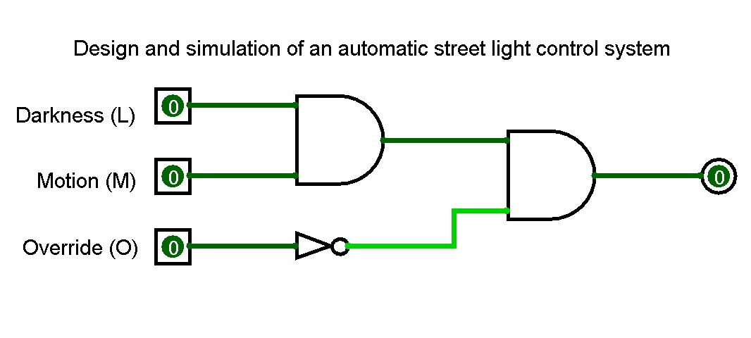
Automatic Street Light Control System
Simulation
Truth Table
Darkness | Motion | Override | Light
0 | 0 | 0 | 0
0 | 0 | 1 | 0
0 | 1 | 0 | 0
0 | 1 | 1 | 0
1 | 0 | 0 | 0
1 | 0 | 1 | 0
1 | 1 | 0 | 1
1 | 1 | 1 | 0
AND Gate
NOT Gate

Slide 8
Automatic Street Light Control System
Results And Advantages
Results
Advantages
The system successfully detects daylight and darkness.
Street light turns OFF during daylight.
Street light turns ON automatically at night.
Simulation confirms the expected switching operation.
Can be implemented for multiple street lights
Reduces energy wastage
Minimizes human intervention
Provides automatic operation
Simple and cost-effective system

Slide 9
Automatic Street Light Control System
Conclusion And Future Scope
Conclusion
Future Scope
Designed an automatic street light control system using light intensity detection.
The system automatically switches lights ON in darkness and OFF in daylight.
Simulation verifies the correct operation of the system.
The design helps reduce energy wastage and manual intervention.
Integrate IoT-based monitoring and control.
Use LED lighting for better energy efficiency.
Add motion sensors to control brightness
based on road activity.
Develop a smart city-wide lighting system.

Slide 10
Thank You
Design and Simulation of an Automatic Street Light Control System

